Slide 1
True Colors
Power point by Preston Allen

Slide 2
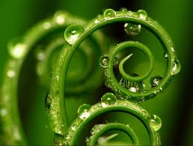
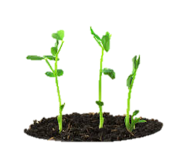
All about the greens!
Hi my name is Preston Allen I am a green here are characteristics of a green…
A green loves puzzles and board games
They also love research and are always seeking knowledge
I believe I am a green because I love knowledge and I have the desire to learn
I also love puzzles and having a good time
Lastly My friend peter is a green we all say that he loves math and he loves research these are all characteristics of a green. An example is he loves to do research even if he's not supposed Also he loves learning new things every day.

Slide 3
All about the blues!
Its me again I'm going to be talking about the blues now a blue is…
A very carrying person
Doesn't want to lose friendships
Is nice
Lastly a very good and sweet person
An example of a blue is my good friend Brendan who loves to have a good friend ship and is very caring. Once his step brother was being bullied and Brendan stood up for him. Lastly he helps kids around the school like picking up there stuff.

Slide 4
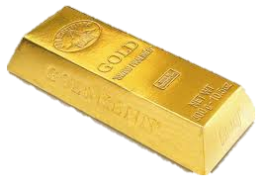
All about the gold's!
I'm here once again I know here are the characteristics of a gold…
They are very neat and tidy
They also are very organized
In addition they need rules or structure
Lastly they do not get along with oranges..
An example of an gold is my dad he has all of the characteristics of a gold. A good Example is how organized he is with all of his work. Also he is very good at keeping stuff neat and tidy he cant stand a messy house.

Slide 5
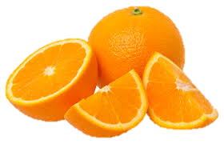
All about the oranges
I'm back Hey so these are the characteristics of orange the final color…
They are very generous
Also they are very active
They have a wonderful imagination
Are bold in friendships
Lastly there drawn to tools
An example of an orange is one of my good friends Christopher a huge example is that he is very active he plays 3 different sports!

Slide 6
All about me
I'm a green in the very first slide I described the characteristics of a green so lets jump right into it
An example of why I'm a green is a big one I love learning! Learning is a huge part of a green I also love math and research. One Specific example is that one hot Saturday I Was inside about to go to my friends house then I said why don’t I research. Lastly I love math which also incorporates into green.

Slide 7
Fun facts about the colors
My whole Family's a gold but gold is my lowest score.
One of my friends scored orange and blue
Almost all my friends are blue.
The end

